Slide 1
A Proposal for Mitigating Ransomware Attacks
By Bennett Hall

Slide 2
A Problem and a Proposed Solution
Ransomware has been a significant cyber threat for several years
The past couple of years have witnessed a significant uptick in the frequency and success of ransomware attacks. Because of the ransomware attacks against the Colonial Pipeline and the JBS meat processing operation this year ransomware has received additional public scrutiny
Organizations are pumping significant resources into preventing ransomware attacks from occurring. Yet, despite these efforts ransomware persists as a problem. One that still needs a solution
I propose that we eliminate the use of RDP and email in the workplace to mitigate the ransomware threat

Slide 3
What is Ransomware?
Ransomware is essentially a form of malware that encrypts a target's files, folders, and hard drives, or in many cases entire devices. Once the files or whole devices are encrypted they become inaccessible to the victims. Then the attackers demand ransom money from the target in exchange for a key to decrypt the encrypted files or devices
Victim organizations, once infected, are faced with the difficult choice of either paying the ransom demands and hoping for restored access or not paying and the ransom demands and incurring the wrath of the attackers. Victim organizations are generally discouraged from paying the ransom

Slide 4
What is Ransomware (continued)?
There are two types of ransomware: crypto and locker. Crypto ransomware will encrypt files, folders, and hard drives on devices that it infects. Locker ransomware actually locks users out of their devices altogether
It’s important to note that ransomware attacks are generally understood to be perpetrated by criminal groups
Ransomware as a service is when a particular ransomware group opts to sell or lease its code or software to affiliate groups so that they too perform ransomware attacks. Ransomware groups like Babuk, REvil, and Conti have taken their ransomware code and offered it up to other groups to use to execute their ransomware campaigns

Slide 5
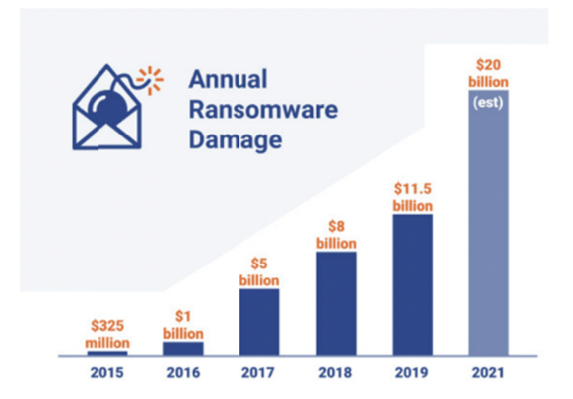
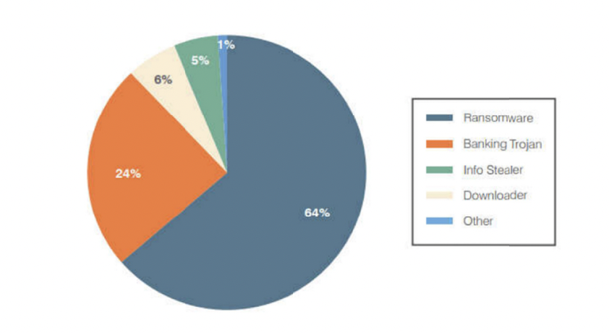
Why Ransomware is a Problem
Since 2019 ransomware attacks have increased 239%
Ransomware is expected to cost victimized organizations approximately $20 billion in 2021
On average, ransomware attacks are expected to successfully infect a target and encrypt their systems every 11 seconds
Ransomware has become the most significant cyber threat out there today
As evidenced by these statistics we can see that ransomware is a serious problem

Slide 6
Reiterating My Proposal
I propose that we eliminate the use of RDP and email in the workplace to mitigate the ransomware threat
Approximately 80% of all ransomware attacks that successfully encrypt a target’s data or whole systems come from two sources
The exploitation of RDP accounts for about 40% of all ransomware attacks
Phishing attacks also account for about 40% of all successful ransomware attacks

Slide 7
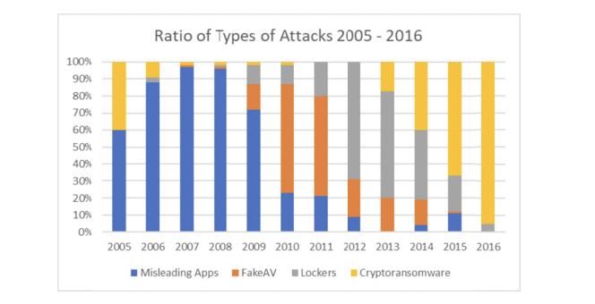
Existing Proposals to Mitigating Ransomware
There are a lot of ideas and proposed solutions out there. Some work better than others, but as demonstrated by numbers cited earlier in this presentation, ransomware attacks are occurring more frequently and not less frequently. Our best efforts to mitigate ransomware are not working and we need more comprehensive solutions
Before I present my proposed solutions in depth it seems prudent to examine existing solutions to demonstrate why they are not working and why the ransomware problem persists
While organizations continue to invest more in employee training to stop ransomware, the threat has continued to grow. Ransomware is now the most common form of extortion

Slide 8
Employee Training
Employee training is a common existing solution for mitigating ransomware attacks that teaches employees how to spot phishing emails
Organizations are investing significant resources into employee training with the goal of stopping or mitigating ransomware attacks, yet the ransomware threat has continued to grow
According to the US Department of Labor there are 164 million people in the labor force. Granted not all of them have or use email, but the point is to think about scale. On average an office worker receives 121 emails per day. Even if only half of the employees in the US labor force use email that equals about 10 billion emails received per day
This leaves a lot of opportunity for ransomware groups to execute phishing campaigns
Employee training, while noble, is simply insufficient with so many emails being sent and received each day. How can even the most effective training provide sufficient cover where there are so many emails going out?

Slide 9
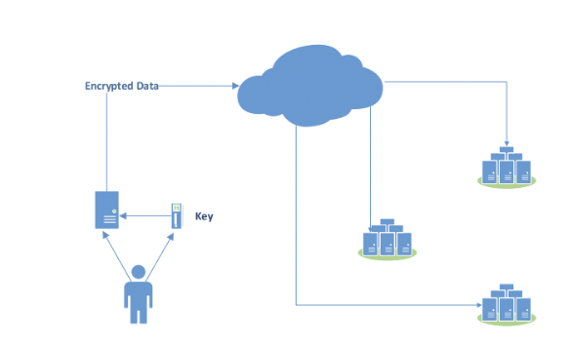
Encryption
Another existing solution that isn't sufficient is encryption. Encryption is an essential tool for any organization to use because it protects confidentiality. Encryption was not designed for the purpose of mitigating ransomware. I do believe in encryption, but not for mitigating ransomware
Encryption has become more sophisticated and there are “smart” methods of encryption. Even these enhanced encryption techniques are insufficient solutions for mitigating the ransomware threat
One sophisticated encryption technique is Dynamic Distributed Secure Storage (DDSS). DDSS also uses local encryption, a deletion based cryptosystem, and resilient storage
An organization could, and should, encrypt its data, but ransomware can still encrypt and block access to your already encrypted data. Simply encrypting confidential data will not stop a ransomware attack from occurring
Think of it like this. You store your valuables, like jemerly or documents like a social security card, in a safe at home or in a hotel room. A malicious actor can still come in place a lock on that safe and prevent you from getting to your valuables. The same is true for data. If an organization is infected with ransomware it doesn’t matter whether the encryption is more basic or more sophisticated, like DDSS, that organization will still be locked out of its own data or systems

Slide 10
Backups
Having good backups is an invaluable strategy for any organization to protect its data. However, it still is not enough to mitigate ransomware attacks
Data backups allow for the recovery of data when critical data is erased or altered or otherwise becomes inaccessible. Data backups can be stored onsite or offsite
I will concede that having secure offsite backups may help mitigate ransomware attacks to some extent, but so far that has not been the case as ransomware attacks are occurring with increasing frequency
Backups also cannot protect an organization from being locked out of their devices. Even with reliable backups there will still be a disruption in services. In some cases it is possible for ransomware to infect and lock the backups
Data backups were never intended to protect an organization from ransomware and we cannot rely on them to do so

Slide 11
Eliminate RDP in the Workplace
RDP, Remote Desktop Protocol, is a Windows technology that allows users to communicate with one another over a network with a graphical interface. RDP also allows users to remotely control Windows computers
RDP is deprecated and Microsoft no longer supports it, yet it still accounts for about 40% of all ransomware attacks
Typically ransomware attackers will attempt to brute force an organization's RDP protocol with usernames and passwords until they have successfully authenticated themselves inside of a target network. Once inside of the target network the attackers can unleash the malware to encrypt the target's data or whole systems

Slide 12
Why it Works
Again, RDP accounts for about 40% of all ransomware attacks. By eliminating its use we can remove it as an attack vector altogether. It’s a comprehensive solution that mitigates an attack vector that is exploited in nearly half of all ransomware attacks
The technology is deprecated and cannot be made to be more secure so any attempts at doing are futile
By eliminating RDP in the workplace ransomware attacks become much more difficult for malicious actors to conduct. This action forces ransomware groups to use other means of execution for their attacks

Slide 13
Alternative Technologies to RDP
Royal TS is a good alternative to RDP. Royal TS provides the access and functionality that RDP offers, but does so with access and security in mind. Royal TS gives users the ability to remotely access computers, perform tasks, troubleshoot, and monitor systems. Royal TS also supports other protocols and uses a stronger access credentialing system than RDP for enhanced security
RDP is a Microsoft technology and therefore it’s obviously not compatible with Mac devices. Screens is a technology that offers RDP services for Mac devices with an SSH connection. Mac usage is common enough that this technology merits consideration
Terminals is an open source desktop manager that also offers other protocols in addition to its RDP-like functionality. Because it’s open source it may be a good option for smaller organizations to implement

Slide 14
Eliminate Email in the Workplace
Email is a big part of everyday life. Whether at home or in the workplace. Ransomware groups exploit email in the workplace because it’s such a large target
Attackers send emails that appear legitimate, called phishing, to people inside of a target organization. The ransomware groups attempt to trick unsuspecting people into clicking on malicious links in the email or opening malicious attachments. Once the link or attachments have been clicked on the malware executes and is unleashed on the network to encrypt the data and/ or systems
Email is an attack vector used in about 40% of ransomware attacks

Slide 15
Why it Works
Because email is an attack vector used in about 40% of ransomware attacks, taking away the attack vector altogether provides a comprehensive solution that mitigates nearly half of all ransomware attacks
No existing solution is strong enough to secure email to the point where ransomware attacks are sufficiently mitigated. The number increasing number successful of ransomware attacks validates this
Ransomware is prevalent because it’s easy for attackers to execute, but eliminating email makes ransomware attacks much more difficult for attackers to carry out because the attack vector is removed altogether

Slide 16
Alternative Technologies to Email
Interoffice communication: Slack offers us the ability to perform one of the most important functions of email. Slack is a publicly traded company and its already been widely adopted by organizations
External communication: Twilio is a service that allows employees of an organization to call or text people outside of their organization. Users can interact with clients, prospective clients, partner organizations, etc using Twilio’s communications platform. Twilio can be used to schedule appointments, exchange data, or for general external communications
Document sharing: Services like Dropbox, Airdrop on iPhones, and Google Docs allow people to send and share attachments. These services are household names that everyone knows. They have good reputations and area already widely in use
Scheduling appointments, sending tasks to other people, and staying organized with lists: Asana and Atlassian are technologies that can do all of these things. Asana’s stock is up 250% on the year and Atlassian is also a publicly traded company
All of these technologies are viable alternatives that provide the same services as emails without needlessly exposing organizations to ransomware attacks. These technologies also exist already, making a transition away from email smoother and less daunting

Slide 17
Atos Use Case
Atos Origin, a company of 70,000 employees, announced a move toward zero emails in 2011
The idea to move to a zero email policy stemmed from the CEO noticing that his employees seemed distracted by their emails. Back in 2011 ransomware was not as well known or prevalent as it is today. Obviously for Atos Origin the idea was to see if they could become a more productive company by eliminating email not to mitigate the threat posed by ransomware
However, Atos’ decision to move towards zero email is significant because the company is so large. If a company as large as Atos can make a move like this then certainly it shows that eliminating email in the workplace is absolutely doable
It appears that Atos’ move to zero email has paid off in a couple of ways. I could find no record or mention of successful ransomware attacks against Atos. Also, moving away from email is the workplace has had other benefits for Atos: their operating margins increasing from 6.5 to 7.5, their earnings have increased, and they have enjoyed a three percent reduction in their administrative costs
Atos is using “social networks” to perform tasks that they would normally rely on email for. The social networks that they use are proprietary software and I was not able to find much information on them
Atos has so far reduced its email usage about 60%. They have not moved away from email completely, but they are still working towards doing so

Slide 18
In Conclusion
Up to this point we have been completely unsuccessful in our attempts to reduce the frequency and success of ransomware attacks. Nothing has worked. Ransomware attacks persist and they are causing a lot of harm. We need real solutions. Ransomware is a significant problem and it needs a proportional solution for mitigation. Eliminating RDP and email in the workplace will frustrate ransomware groups by taking away their two biggest avenues for infecting their targets. If we could reduce ransomware attacks by 80% then ransomware as a crime will be a lot less appealing to attackers and it would be much less of a problem

